Slide 1

PlatteVillains – U16
Notes:
Alex to introduce team. Everyone will introduce themselves.

Slide 2
Summary of our work
Analyzed historic trends in MN Twins attendance
Determined factors associated with high-attendance games
Data can be used to help Twins’ make informed business decisions
Dynamic pricing strategies, attendance/customer behavior predictions
Suggest IOT strategies at Target Field
Notes:
Alex
Conclusion: High level BUSINESS STUFF
Recommend – pay attention to incoming strong players, where teams are overall in the standings, look at additional data for stronger intro

Slide 3
Data Sources Provided
Game Logs
2023 Schedule
Max Capacity
PROMOTIONAL DATA
Additional
Data Sources
Notes:
Briefer, include a little less info, say what is in data set, maybe add promotional data set

Slide 4
Data Cleaning
Formatted and Derived Variables
Merged FLO and MIA, Dropped MON
Missing Data
Removed Games
Notes:
From game logs, we formatted date into a date data type, and derived month and year variables from it.
From the 2023 schedule, we used the information given and attempted to derive all possible information from it to match the variables in the game logs. So, from date we derived month, year, and day of week. From the time the game started we determined if it was a day or night game.
We were able to add the league and game number for both home and visiting team. Finally, ballpark id was derived from the stadium the team played at in 2022 as we didn’t identify any stadiums being built this year. It also allowed us to filter out any unusual stadiums.
Finally, we filtered out any games that had 0 attendance or were affected by tragedy. So, the remainder of the games in 2001 after 9/11 as well as the games up through June in 2021. The decision to stop at June was we looked at the overall year pattern for the teams, and in 2021, the pattern matched from June onward, but before June it was abnormally low attendance

Slide 5
Attendance Distributions
Notes:
Jessica

Slide 6
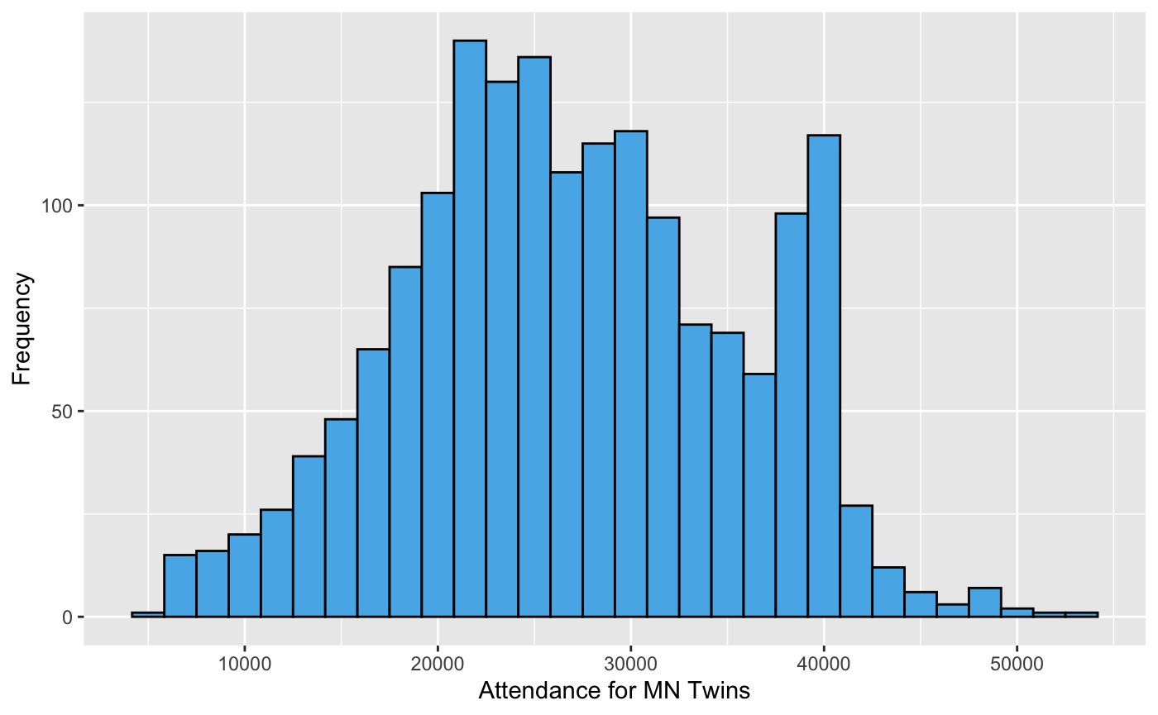
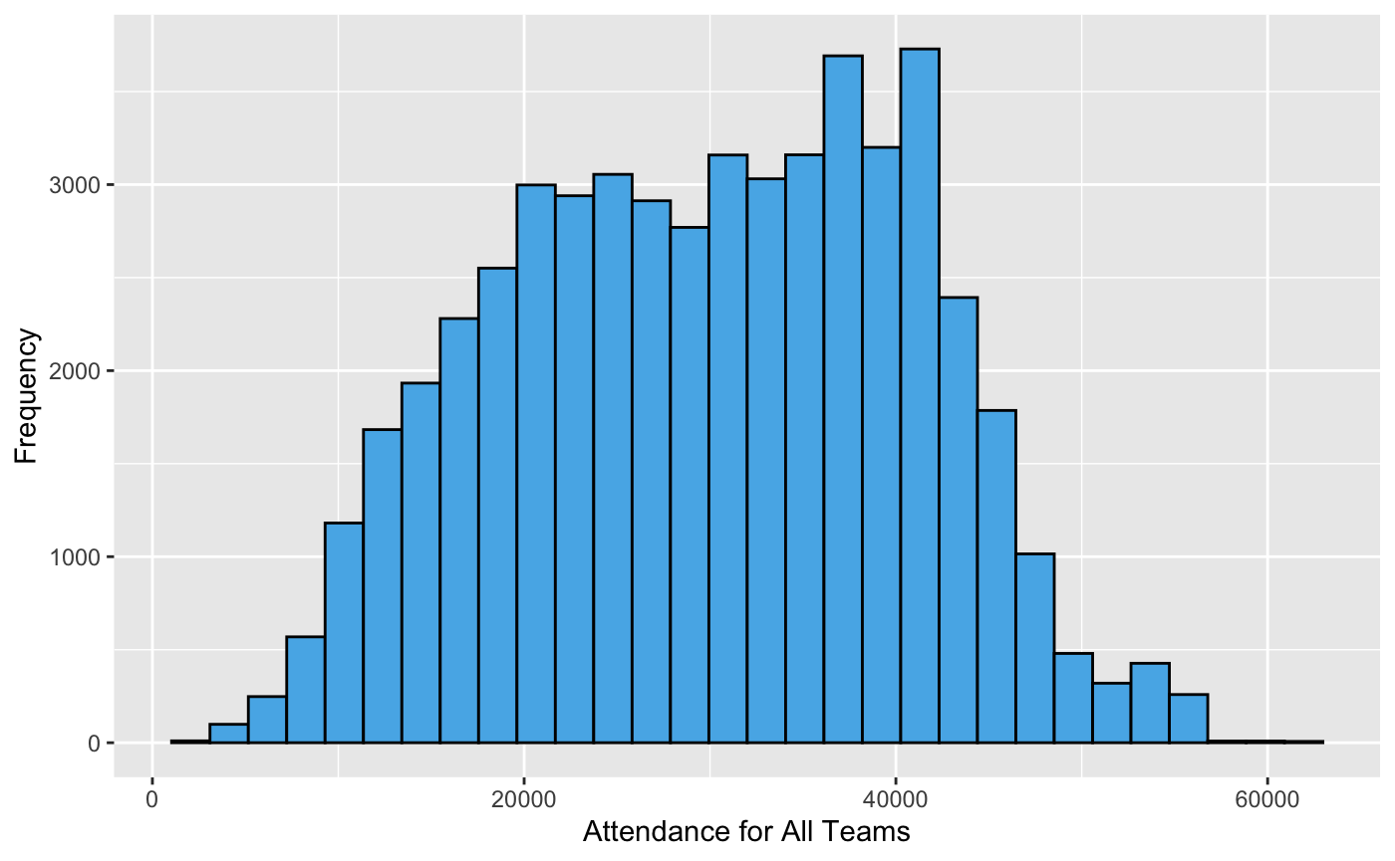
MN Twins All Teams
Notes:
Jessica
TWINS
Mean is around 25,000 and the attendance ranges from about 6,000 to 54,000
Min. 1st Qu. Median Mean 3rd Qu. Max.
5753 20614 26174 26695 33107 54088
ALL
Mean is right around 30,000 and the attendance ranges from about 1,100 to almost 62,000
Min. 1st Qu. Median Mean 3rd Qu. Max.
1107 20853 30084 29592 38487 61707
Add some color to these. Why is it difficult to get over the ~40,000 attendee threshold?

Slide 7
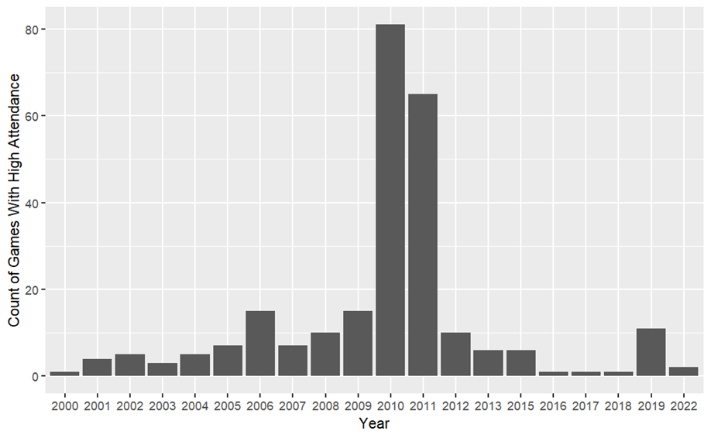
Minnesota High Attendance Games
Notes:
Do games with over 37,500 attendees occur on one particular day of the week? On a particular month? etc

Slide 8
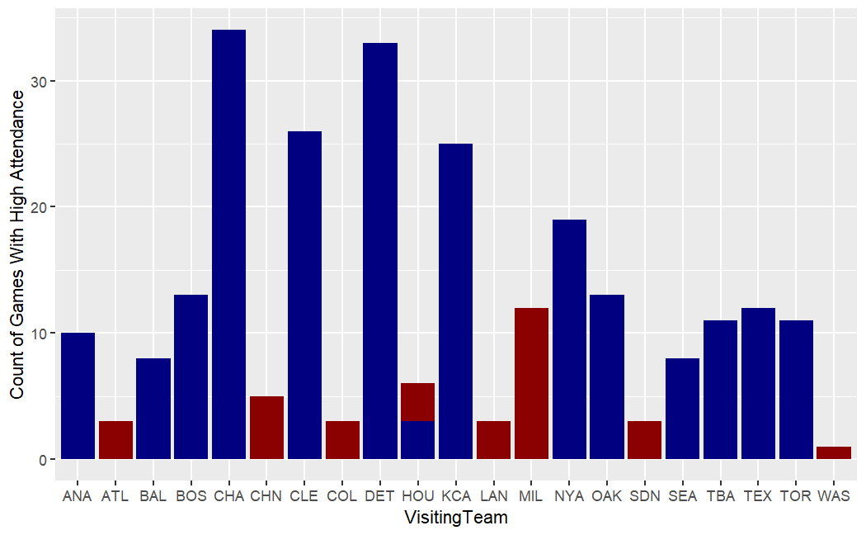
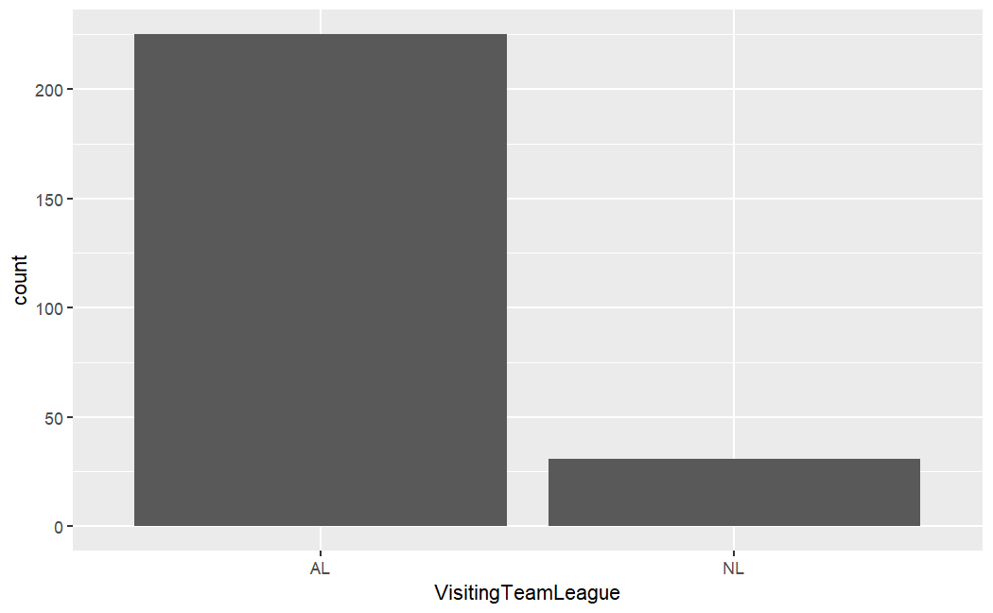
Minnesota High Attendance Games
Notes:
Do games with over 37,500 attendees occur on one particular day of the week? On a particular month? etc

Slide 9
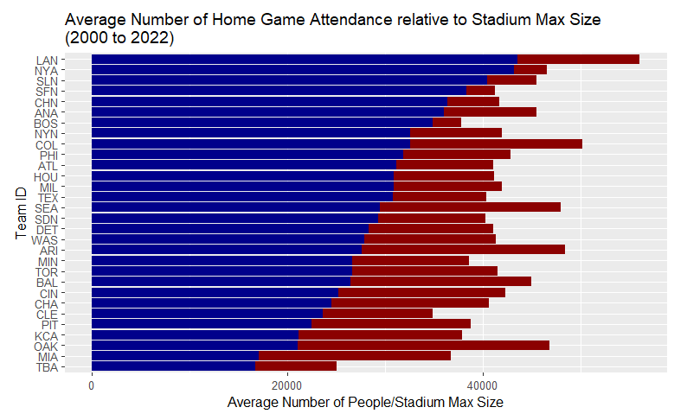
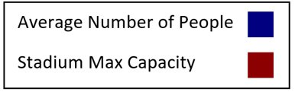
Notes:
Nolan
Next, to get an idea of what teams are popular, we looked at how full each teams stadiums on average for all if the teams home games over the years. The data shown on this graph is from 2000 to 2022. The blue shows the mean number of people that attended each teams home games and the red shows how full the stadium can be. LAN, NYA, SLN, SFN, and CHN had the highest average attendance at their home games.
LAN - Los Angeles Dodgers
NYA - New York Yankees
SLN - St. Louis Cardinals
SFN - San Francisco Giants
CHN - Chicago Cubs

Slide 10
Influential Factors
Notes:
Jessica

Slide 11
Numeric Features
Game Number
Month
YEAR
Notes:
Jessica

Slide 12
Categorical Features
Day or Night Game
Home/Visiting Team
Day of Week
Home/Visiting League
Notes:
For influential categorical features, we found four to be the most impactful in our model. These included whether the game was a day or night game, what day of week the game was, who the home/visiting team was, and what league the home/visiting is in. We also looked at ball park id but it had high multicollinearity with home team. We didn't use any of the other categorical variables such as starting pitcher since it hard to see any effect on the model or the information wasn't available for the 2023 season.

Slide 13
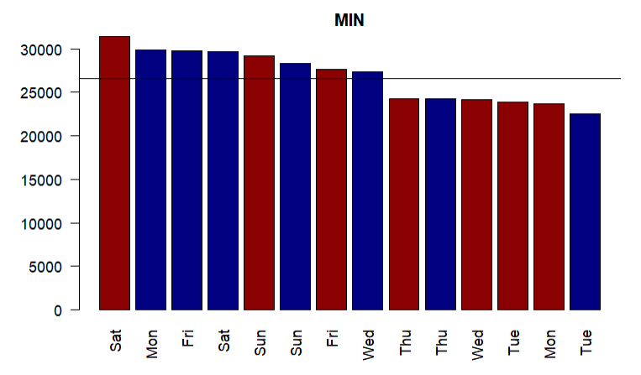
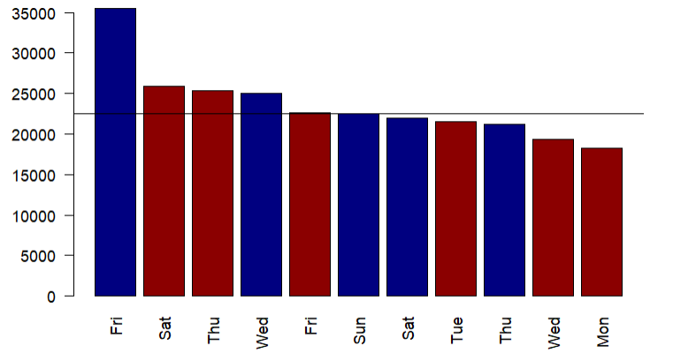
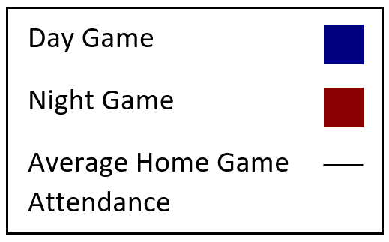
Average Home Game Attendance by Day
of Week and Time of Day (2000 to 2022)
Average Home Game Attendance by Day
of Week and Time of Day (2022)
Minnesota Twins
Notes:
So out of the useful categorical variables we picked a few to look at in. Starting off with day of week and time of day, the graph on the left shows data from 2000 to 2022 and the graph on the right shows data from just 2022. Both graphs show the average home game attendance for the Minnesota Twins separated by day of week and time of day (anything after 5 was a night game). Across all years Saturday night games and Monday and Friday day games had the highest attendance on average.

Slide 14
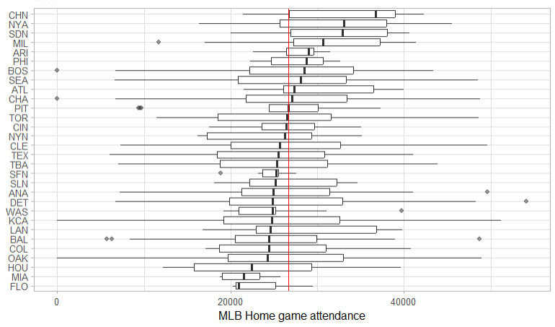
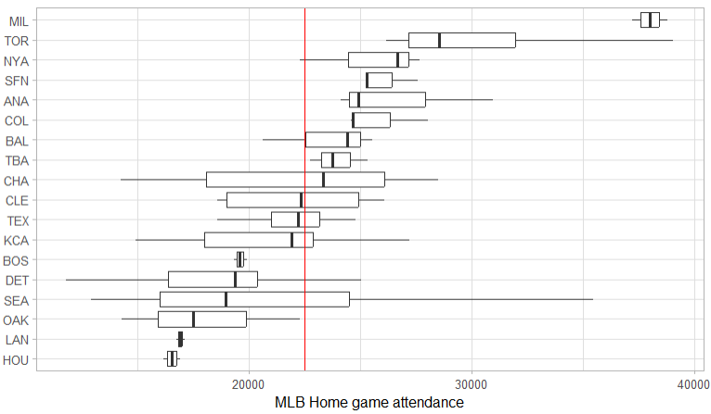
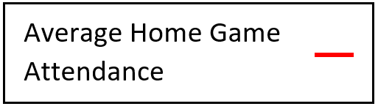
Average Home Game Attendance by Visiting Team (2000 to 2022)
Average Home Game Attendance by Visiting Team (2022)
Minnesota Twins
Notes:
The next categorical feature we look at was visiting team. Here once again the left slide shows data from 2000 to 2022 and the one on the right shows just 2022 data. These graphs are also showing average for home game attendance. This average is shown on both graphs by the vertical red line. From these graphs it shows that CHN, NYA, SDN all drove up attendance for home games over the course of all the years as seen on the left graph. On the right graph an interesting feature we notice was that MIL massively drove up attendance for the 2022 season.
CHN - Chicago Cubs
NYA - New York Yankees
SDN - San Diego Padres

Slide 15
Implications for Dynamic Ticket Pricing
Day of week, game start time, teams playing, etc. affect attendance
Weekend games, rivals, high team offensive strength draw bigger crowds
~80% of team revenues come from local revenues
Concessions, media contracts, ticket sales, parking, etc. (Denaux et al., 2011)
Highlights importance of attendance
Prices for high-demand events can be raised
Aligns ticket face-value with market-value
Notes:
Alex – include links for sources here and on other slides but don’t have to talk about it

Slide 16
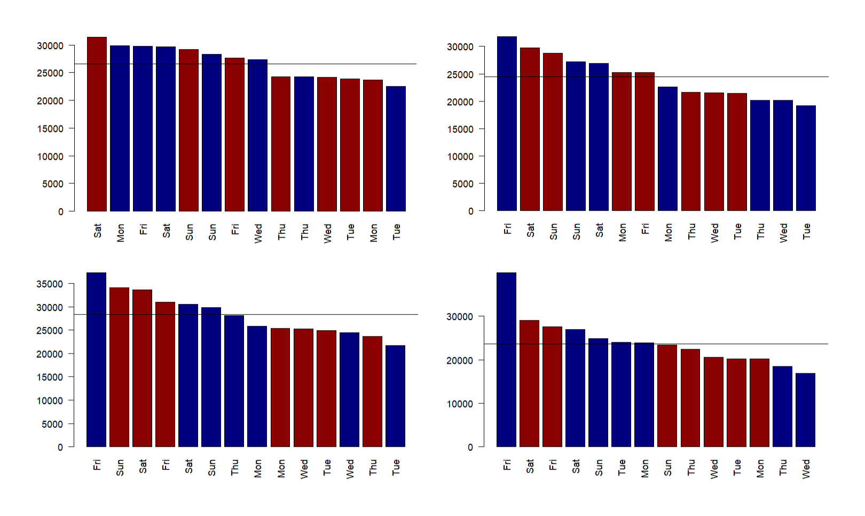
Average Home Game Attendance by Day of Week and Time of Day (2000 to 2022)
Minnesota Twins
Chicago White Sox
Detroit Tigers
Cleveland Guardians

Slide 17
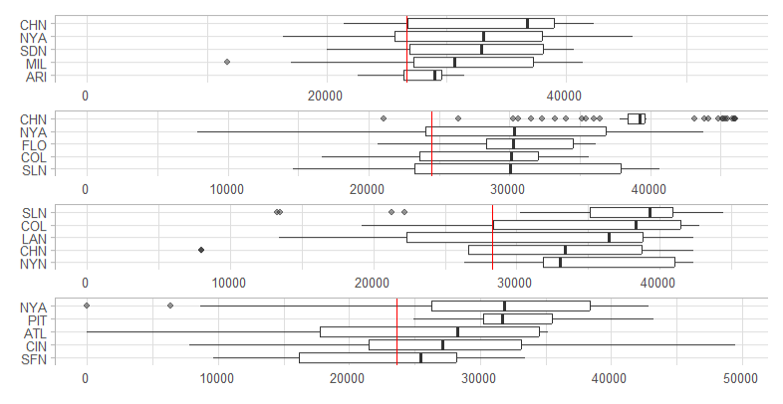
Average Home Game Attendance by Visiting Team (2000 to 2022)
Minnesota Twins
Chicago White Sox
Detroit Tigers
Cleveland Guardians

Slide 18
Comparing MN Twins trends to All Teams
Similarities
Differences
Game numbers
Highest positive correlations for MN Twins and all teams
Offensive features are more likely to be significant
Year
Positively correlated for MN Twins
Negatively correlated for All Teams
Length of game
Negatively correlated for MN Twins
Positively correlated for All Teams
Notes:
Game number – where they are in the season (make sure to mention/explain)
Length of game in minutes

Slide 19
Predicting Attendance
Notes:
Jessica

Slide 20
Prediction Modeling
Machine learning methods used:
K-Nearest Neighbors (KNN)
Generalized Linear Model with Lasso or Elastic-Net Regularization (GLM Net)
Gradient Boosting Machine (GBM)
Random Forest
Methods can be found in multiple R libraries and use MLR to run
Base lm function with Random Forest
R Libraries kknn, h2o, and glmnet
Variables used from stepwise model and correlation matrix
All models went through 30 iterations of cross validation
Notes:
Collin, know what these are, but don’t spend too much time on this slide. Don’t give it to them unless they ask. Otherwise, just list them off.
KNN model looked at the closest 20-neighbors to find which ones were the most similar in terms of attendance
GBM uses a linear model based on all the variables and compares one model to the next
GLM Net is a form of GLM that uses Elastic-Net Regularization and helps when there are multiple highly correlated variables
Random Forest creates an optimized decision tree based on the variables and values given

Slide 21
Prediction Method Results
Machine Learning Method | Average R-Squared Value | Explained Variance | Mean Absolute Percentage Error
GLM Net | 54% | 54% | 24%
KNN | 68% | 62% | 19%
GBM | 71% | 59% | 18%
Random Forest | 81% | 71% | 13%
Notes:
Include other metrics/numbers to supplement the R-Squared value
R Square measures relative overall explanation from all variables in the model – how well a model performs – raw sum of squares score
Explained variance is based on biased variance to determine the fraction of variance explained
MAPE measures mean error of the model

Slide 22
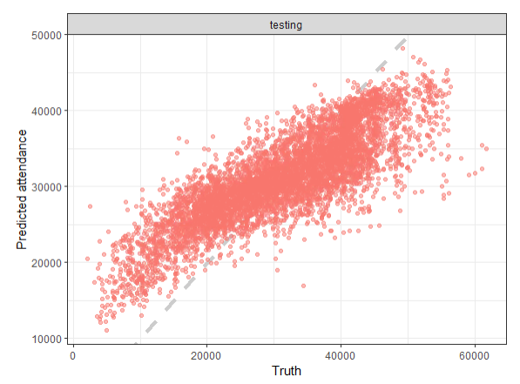
Random Forest with all features
Wanted to test predictions based on strength of random forest
R-sq = 60.37%
Notes:
Jessica
For testing data, so not used to train the model
See “Random Forest Model with all features” in additional info for more details
MSE = 46,315,805

Slide 23
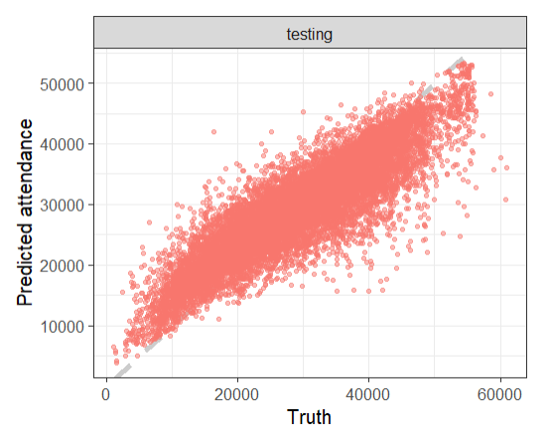
Random Forest with derived features
Tested the model using variables found in a correlation matrix and stepwise model
R-sq = 80.23%
Notes:
Jessica
Split = pred in prediction csv file
All train = pred_all in prediction csv file
See “Random Forest Model with derived features” in additional info for more details
Split into train and test
MSE = 28,117,144
R-sq = 0.7720157
MSE = 24,412,344

Slide 24
Predictive Analytics to Predict Fan Behavior
MN Twins likely have demographic, product usage, and behavioral data on customers
Can be used in CRM systems to segment fan base
Predictive analytics can predict fan behaviors, transactions, etc.
Attendance, ticket purchases/renewals, potential to be upsold
Create fan retention models
Identify causes of churn, improve ROI of cash spent on customer retention
It costs more to attract new customers than to retain current ones
Notes:
Alex

Slide 25
Using Data to Benefit Teams
Notes:
Nolan

Slide 26
Baseball attendance is declining
MLB average per-game attendance has declined since mid-2000s
Twins’ average per-game attendance declined after 2010
2022 average per-game: 22,514 attendees
Potential causes for low attendance include
“Option overload” provides customers with more options for entertainment (Brown, 2019)
Increased competition between sports, streaming services, etc.
Determine what has historically led to high fan engagement
Notes:
Alex
Talk about how baseball is uniquely dependent on in-game attendance. This shows how important it is that fans are drawn to the venue. From there, discuss how attendance figures can be used for future predictions

Slide 27
Improve the In-Stadium Experience
Analyze historical attendance data
Determine optimal staffing and inventory levels
Analyze queue lengths, product demand, and traffic patterns
Optimize event operations in real time
Stadiums must connect teams and athletes to spectators
Data collection touchpoints
Provide a personalized experience
Utilize data on customer interests

Slide 28
Questions

Slide 29
References
Brown, M. (2019, October 4). From Terrible Teams To Rising Costs: Why MLB Attendance Is Down Over 7% Since 2015. Forbes. https://www.forbes.com/sites/maurybrown/2019/10/04/from-terrible-teams-to-rising-costs-and-more-why-mlb-attendance-has-been-down-over-7-since-2015/?sh=3d0214a731a8
‌ ‌
Denaux, Z. S., Denaux, D. A., & Yalcin, Y. (2011). Factors Affecting Attendance of Major League Baseball: Revisited. Atlantic Economic Journal, 39(2), 117–127. https://doi.org/10.1007/s11293-011-9274-2
‌

Slide 30
Additional Information

Slide 31
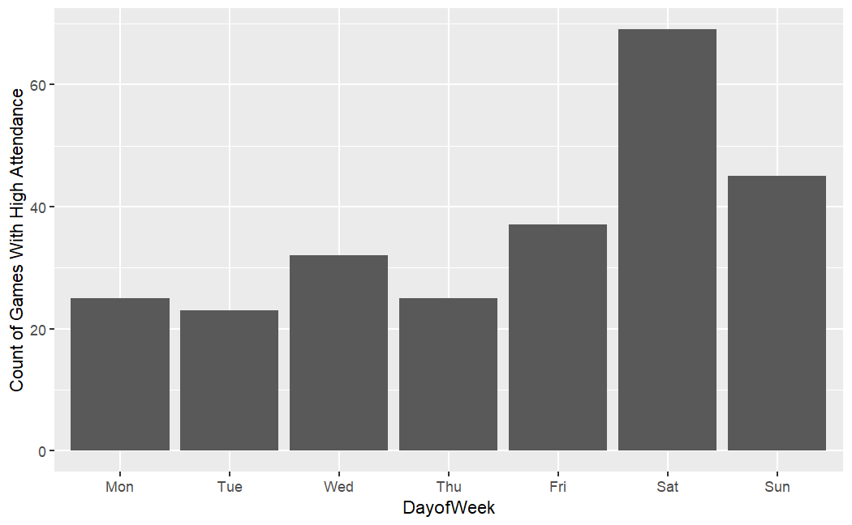
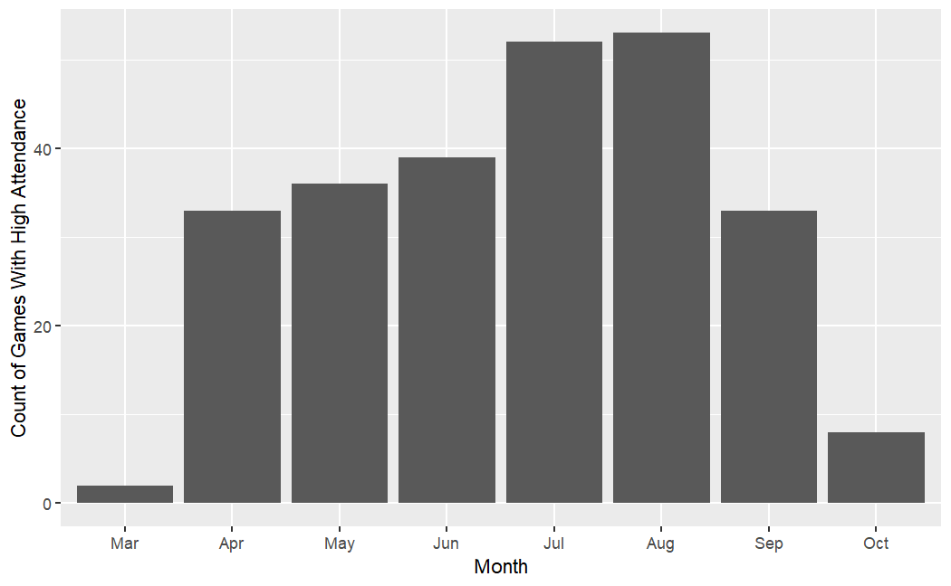
Minnesota High Attendance Games
Notes:
Do games with over 37,500 attendees occur on one particular day of the week? On a particular month? Etc

Slide 32
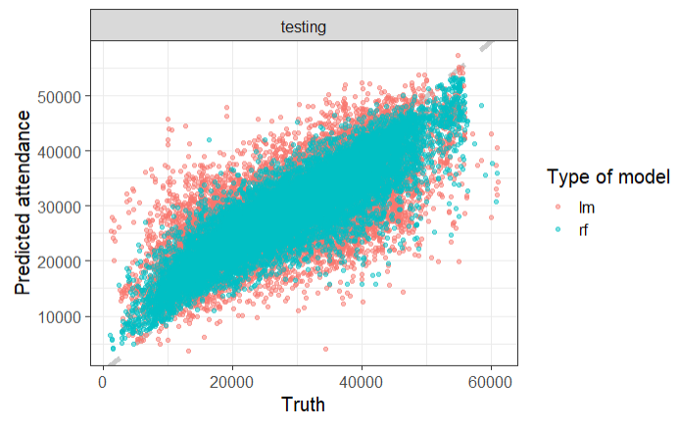
Random Forest vs Linear Regression

Slide 33
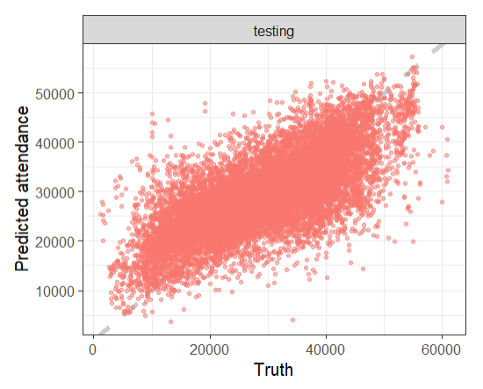
Linear Regression with derived features (glm)
AIC = 827,737
Residual deviance = 2.411e12
Notes:
AIC is similar to R-sq
https://www.guru99.com/r-generalized-linear-model.html
See “Linear Regression Model” in additional info for more details

Slide 34
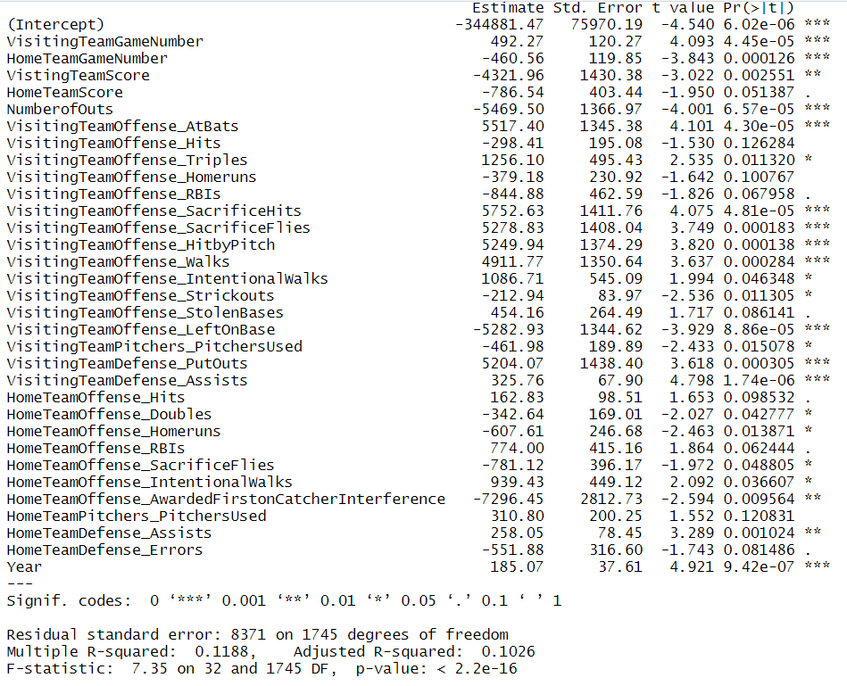
Stepwise Model for just MN Twins

Slide 35
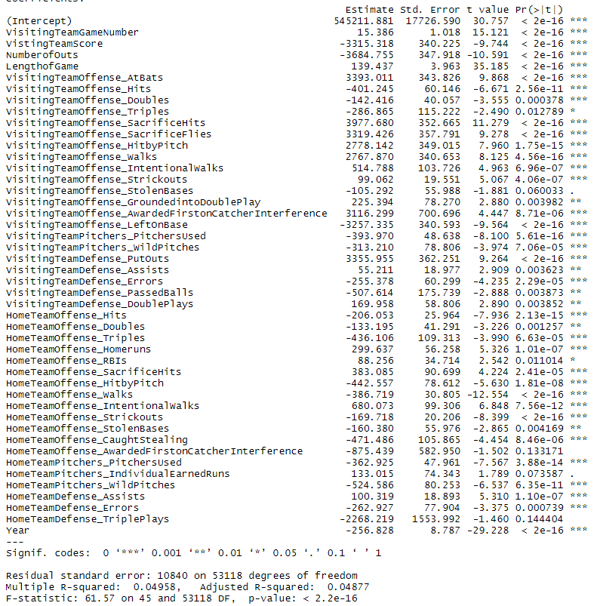
Stepwise Model for All Teams

Slide 36
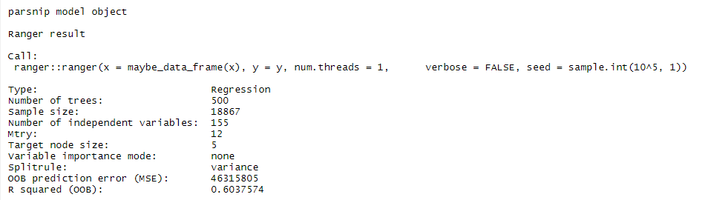
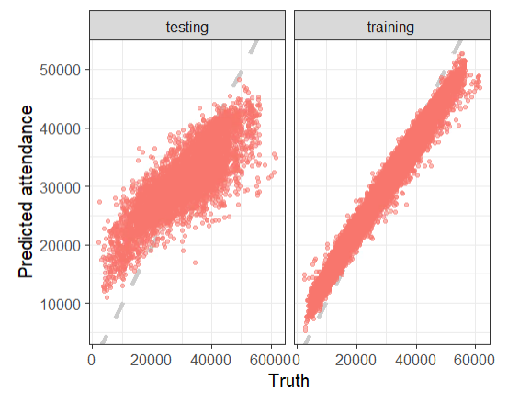
Random Forest Model with all features

Slide 37
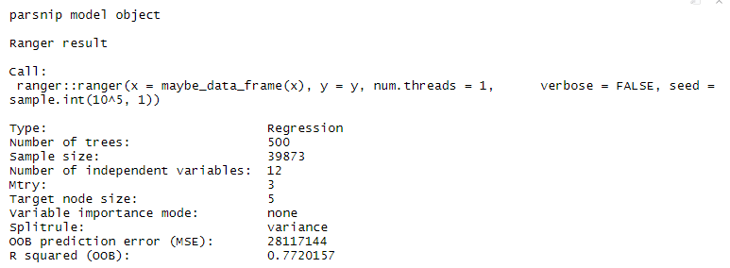
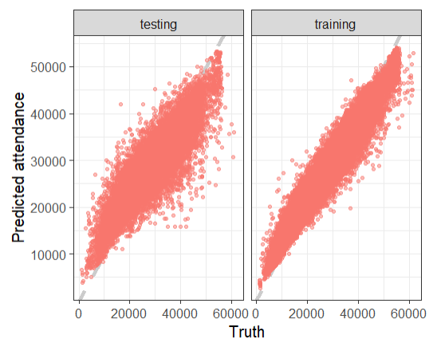
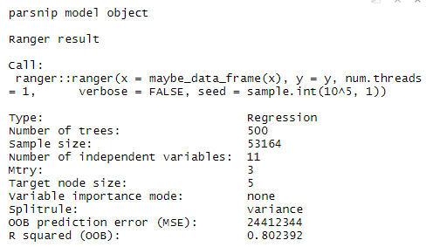
Random Forest Model with derived features

Slide 38
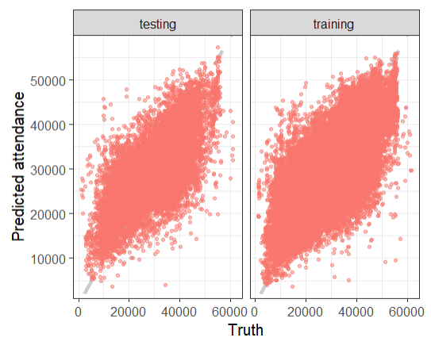
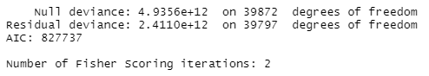
Linear Regression Model

Slide 39
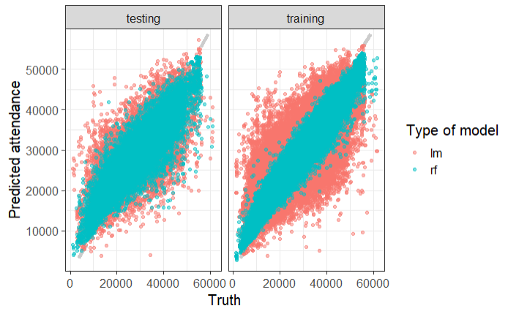
Random forest vs Linear Regression

Slide 40
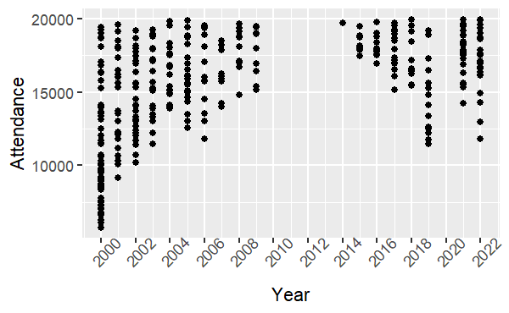
Games with Attendance Less Than 20,000 – Minnesota Only

Slide 41
Stepwise Model with Numerical Features
24 significant features at α = 0.05
More offensive features than defensive features
Those not in top 10 correlation with high significance
NumberofOuts
VisitingTeamOffense_AtBats, SecrificeHits, SacrificeFlies, HitbyPitch, Walks, LeftOnBase, PutOuts, Assists
Adjusted R-sq = 0.1026
F-statistic = 7.35
p-value < 2.2e-16
Notes:
Nolan
See “Stepwise Model for just MN Twins” additional info slide for more details

Slide 42
Stepwise Model for Numerical Features
41 significant features at α = 0.05
More offensive features than defensive features
Adjusted R-sq = 0.04877
F-statistic = 61.57
p-value < 2.2e-16
Notes:
Nolan
See “Stepwise Model for All Teams” additional info slide for more details

Slide 43
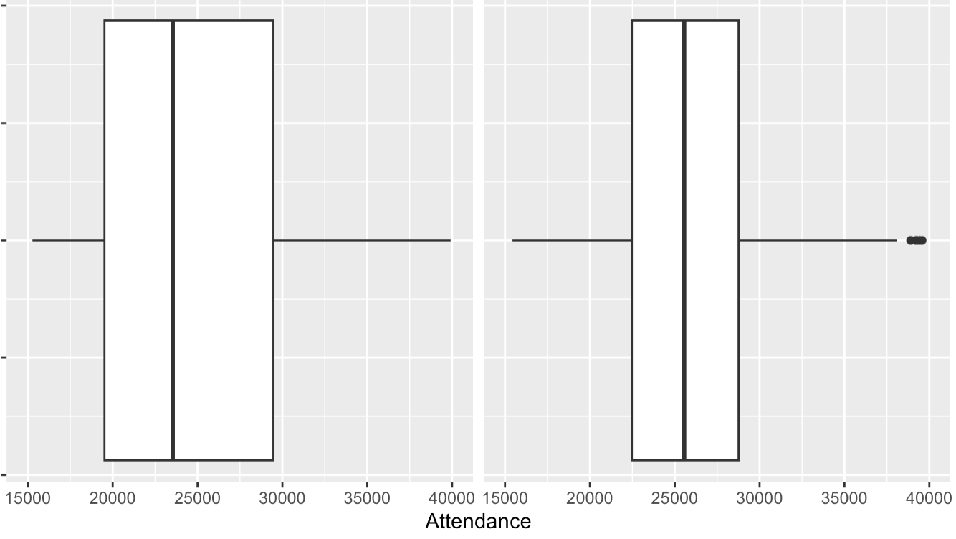
Attendance of Games with vs. without Promotions (2018, 2019, 2022)
Games without promotions Games with promotions

Slide 44
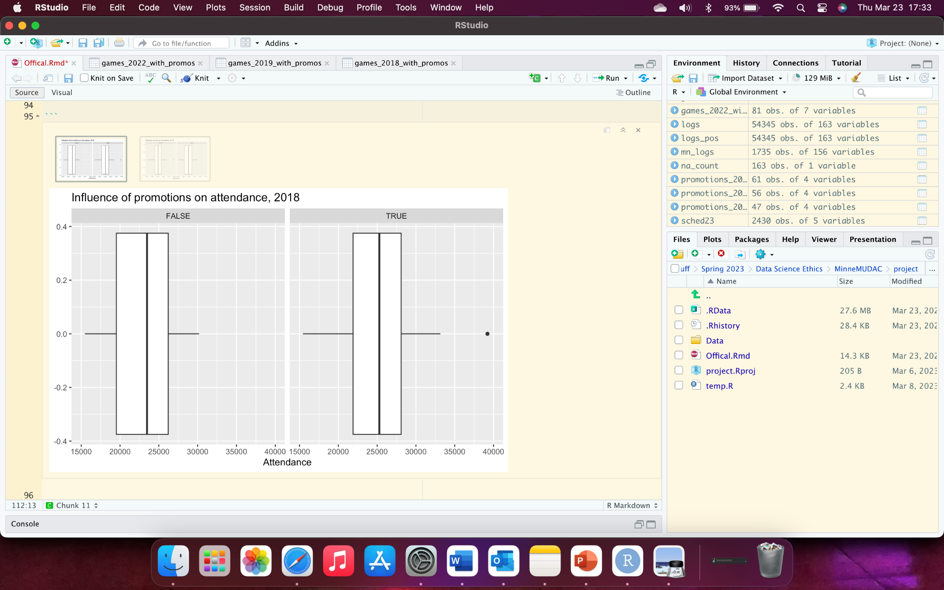
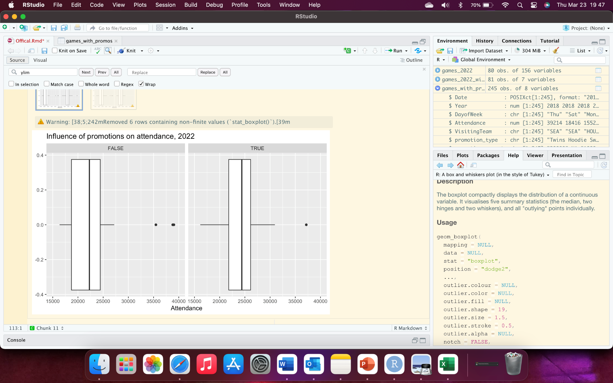
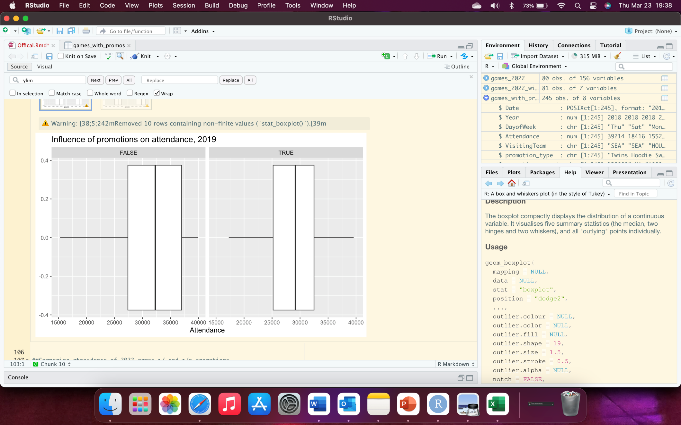
Attendance of Games with and without Promotions, by year

Slide 45
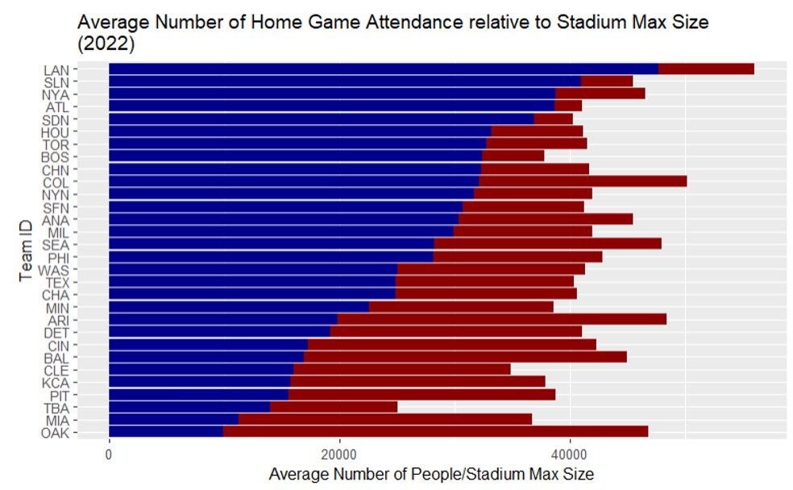
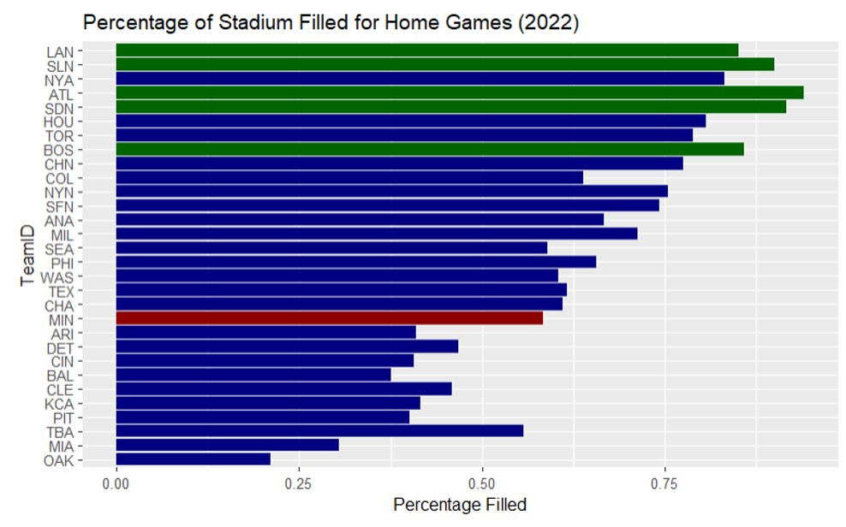

Slide 46
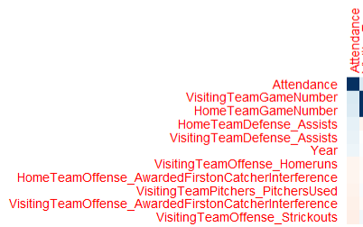
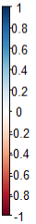
Correlation for Numeric Features (Twins)
Top 5 positive correlation
Range: [0.07, 0.16]
Top 5 negative correlation
Range: [-0.09, -0.06]
Notes:
Nolan: Talk to Makenna on what Nolan should talk to about this slide
VisitingTeamGameNumber: 0.16097027
HomeTeamGameNumber: 0.15650688
HomeTeamDefense_Assists: 0.10151418
VisitingTeamDefense_Assists: 0.09203244
Year: 0.07044340
VisitingTeamOffense_Strickouts: -0.08964019
VisitingTeamOffense_AwardedFirstonCatcherInterference: -0.07263216
VisitingTeamPitchers_PitchersUsed: -0.060
HomeTeamOffense_AwardedFirstonCatcherInterference: -0.05963325
VisitingTeamOffense_Homeruns: -0.05864253
Talk about that we would want to include if we were making a dynamic model (bonus)

Slide 47
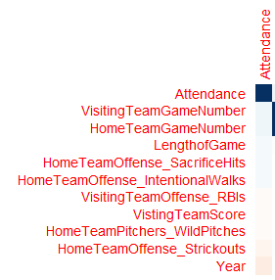
Correlation for Numeric Features (All teams)
Top 5 positive correlation
Range: [0.04, 0.07]
Top 5 negative correlation
Range: [-0.09, -0.05]
Notes:
Nolan
VistingTeamGameNumber: 0.06829327
HomeTeamGameNumber: 0.06808233
LengthofGame: 0.04550247
HomeTeamOffense_SacrificeHits: 0.04528188
HomeTeamOffnse_IntentionalWalks: 0.04475906
Year: -0.10614681
HomeTeamOffense_Strickouts: -0.05379086
HomeTeamPitchers_WildPitches: -0.02803117
VisitingTeamScore: -0.02592760
VisitingTeamOffense_RBIs: -0.02416562

Slide 48
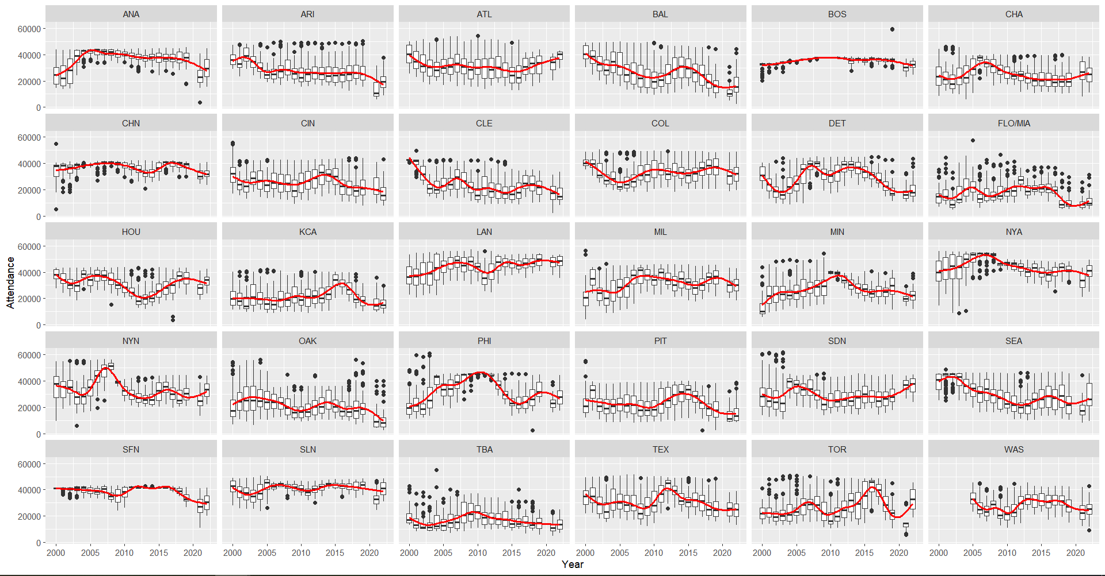

Slide 49
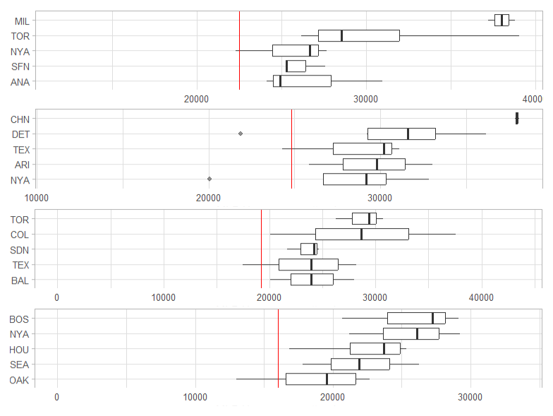
Average Home Game Attendance by Visiting Team (2022)
Minnesota Twins
Chicago White Sox
Detroit Tigers
Cleveland Guardians

Slide 50
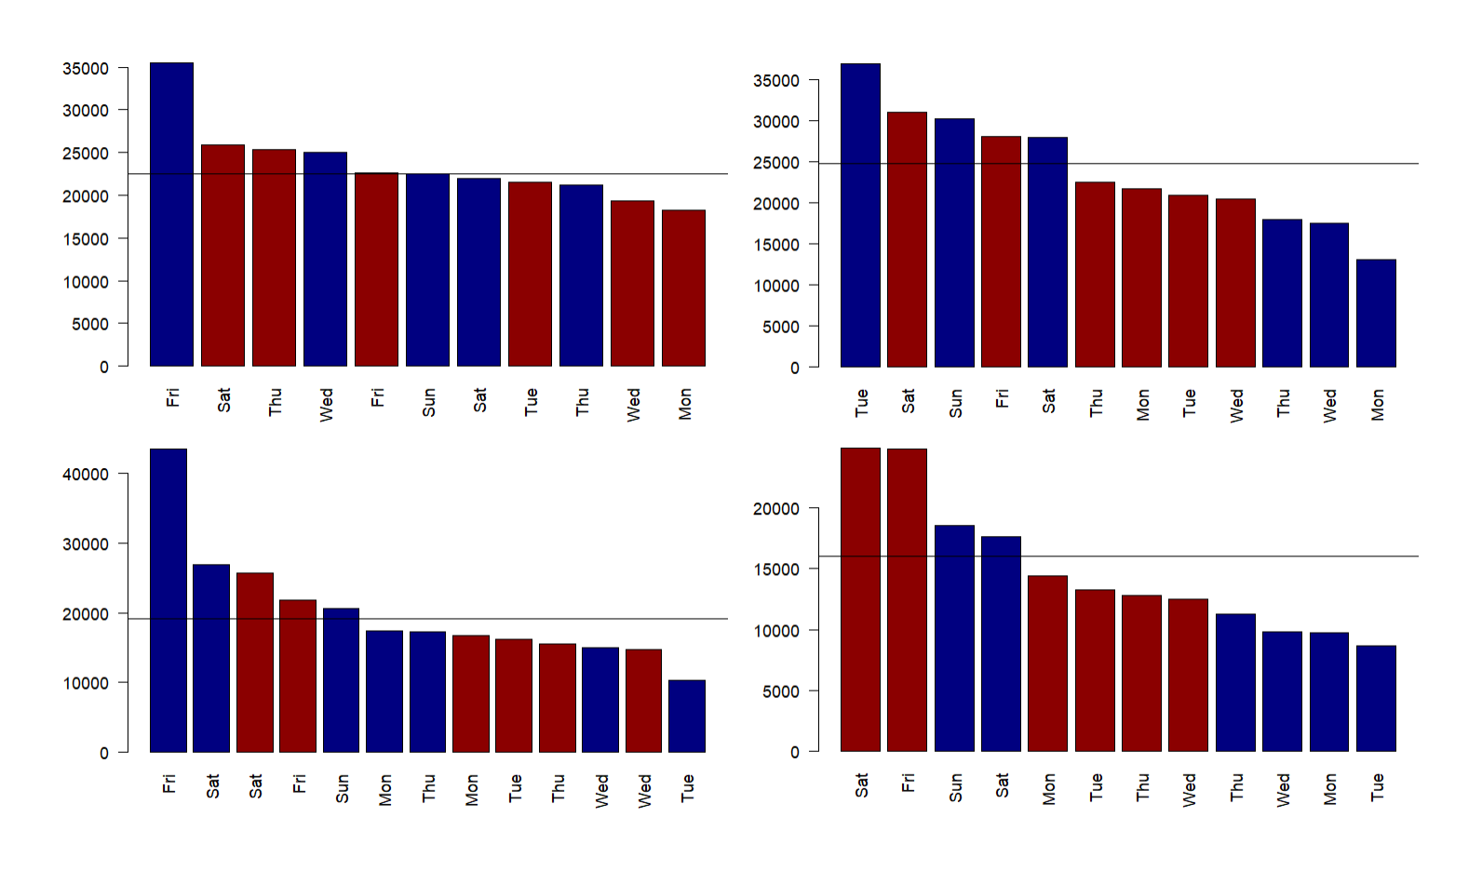
Average Home Game Attendance by Day of Week and Time of Day (2022)
Minnesota Twins
Chicago White Sox
Detroit Tigers
Cleveland Guardians

Slide 51
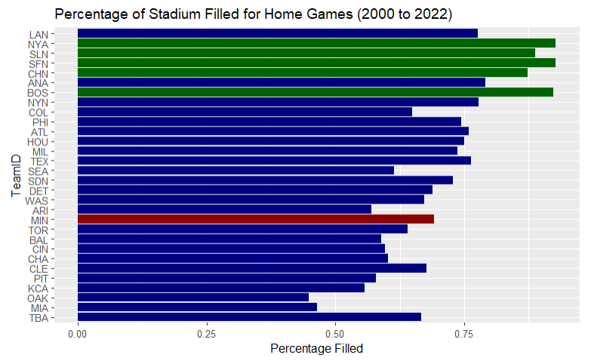
\
Percent Filled > 85%
Minnesota Twins
Notes:
Specify that this was home game attendance
Sorted by average attendance from previous slide, more than 85% filled green, Minnesota is in red
2022 Comparison

